Slide 1

Welcome to Sabbath School
Illustration by Jo Card. Copyright © 2024 General Conference Corporation® of Seventh-day Adventists.

Slide 2
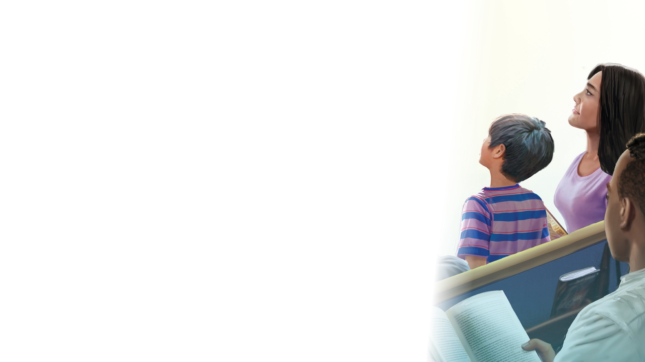
EARLY ARRIVALS
EARLY
ARRIVALS

Slide 3

The Lord’s Prayer
EARLY ARRIVALS
EARLY
ARRIVALS

Slide 4
Books of the Bible
EARLY ARRIVALS
EARLY
ARRIVALS

Slide 5
Welcome to Sabbath School
Illustration by Jo Card. Copyright © 2024 General Conference Corporation® of Seventh-day Adventists.

Slide 6

Alive in Jesus
OPENING ACTIVITIES
Welcome to Sabbath School.
It’s good to see you.
How are you today?
Let’s have some fun
As we learn about God’s love
And follow in His way.
We’re alive in Jesus.
We’re alive in Jesus.
(Repeat above)
"Alive in Jesus" by Rosie Smith, copyright © 2024 General Conference Corporation® of Seventh-day Adventists.

Slide 7
Missionary, Missionary
OPENING ACTIVITIES
Some people far away don’t yet know
That our Lord Jesus loves them so. *Missionary, Missionary, will you go
To bring them the good news of Jesus?
*Doctor, Doctor
*Teacher, Teacher
*Pastor, Pastor
*Farmer, Farmer,
*Builder, Builder
To bring them the good news of Jesus?
"Missionary, Missionary" by Rosie, copyright © 2024 General Conference Corporation® of Seventh-day Adventists. Smith

Slide 8
The Lord’s Prayer
OPENING ACTIVITIES
Our Father in heaven,
Hallowed be Thy name.
Thy kingdom come,
Thy will be done on earth,
As it is in heaven.
(Continued on next slide)

Slide 9
The Lord’s Prayer
OPENING ACTIVITIES
Give us this day our daily bread,
And forgive us as we forgive,
And lead us not into temptation,
But deliver us from evil.
For Thine is the kingdom, the power, And the glory, forever and ever, Amen, amen.
(Continued on next slide)

Slide 10
The Lord’s Prayer
OPENING ACTIVITIES
Our Father in heaven,
Hallowed be Thy name.
Thy kingdom come,
Thy will be done on earth,
As it is in heaven.
(Continued on next slide)

Slide 11
The Lord’s Prayer
OPENING ACTIVITIES
Give us this day our daily bread,
And forgive us as we forgive,
And lead us not into temptation,
But deliver us from evil.
For Thine is the kingdom, the power, And the glory, forever and ever, Amen, amen.
"The Lord's Prayer" by Leanne Erickson, copyright © 2018 Leeann Erickson. Used by permission.

Slide 12
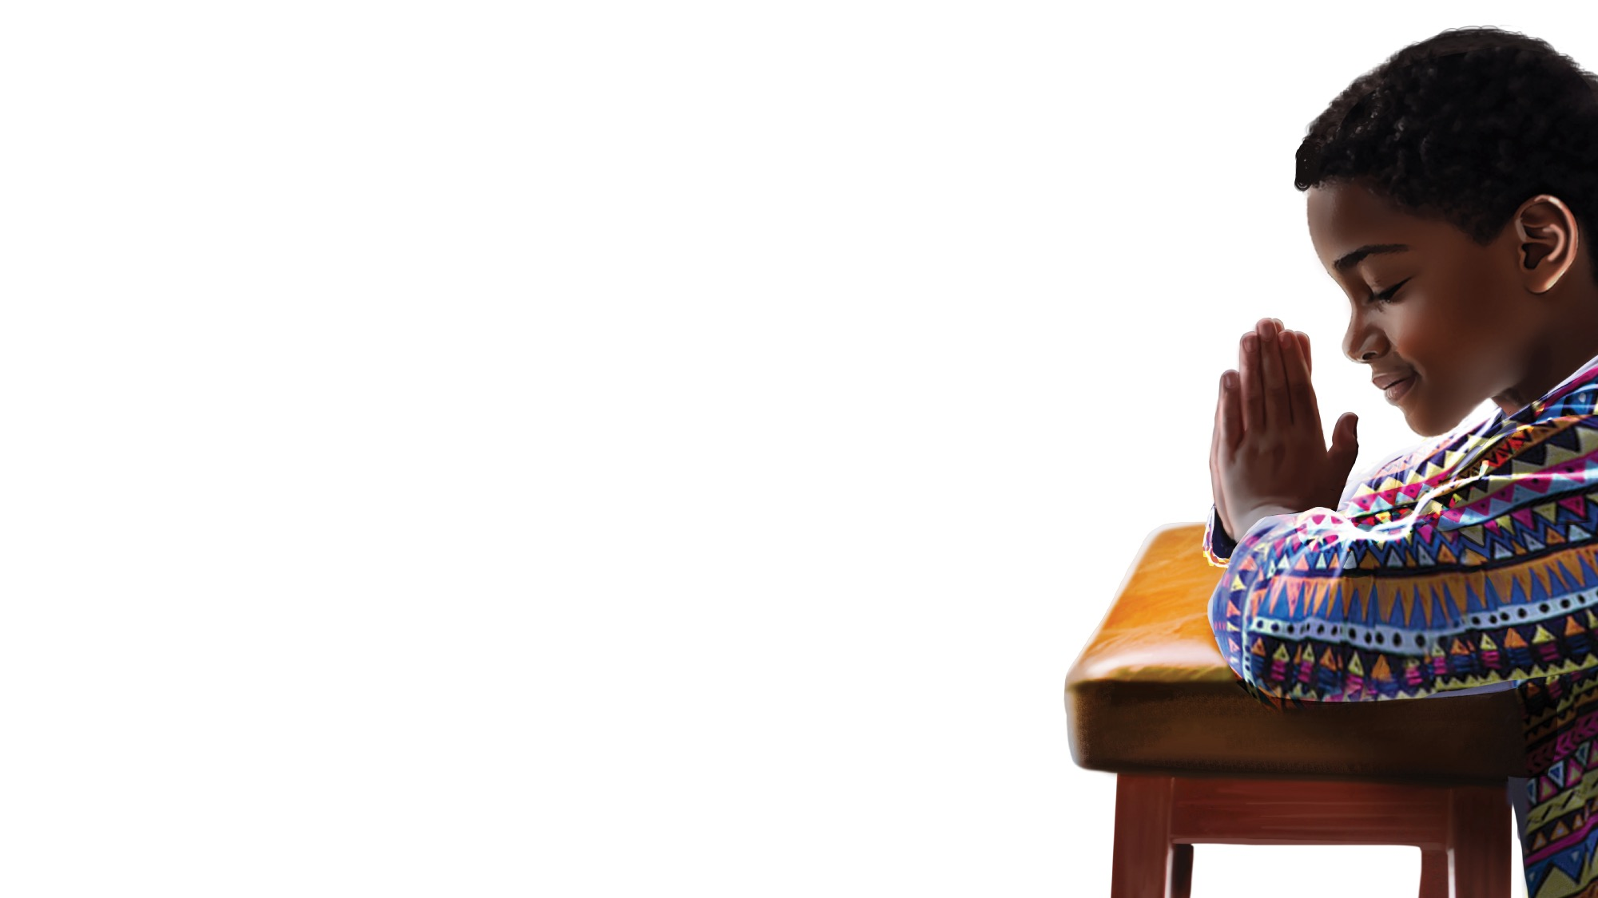
PRAYER
PRAYER

Slide 13
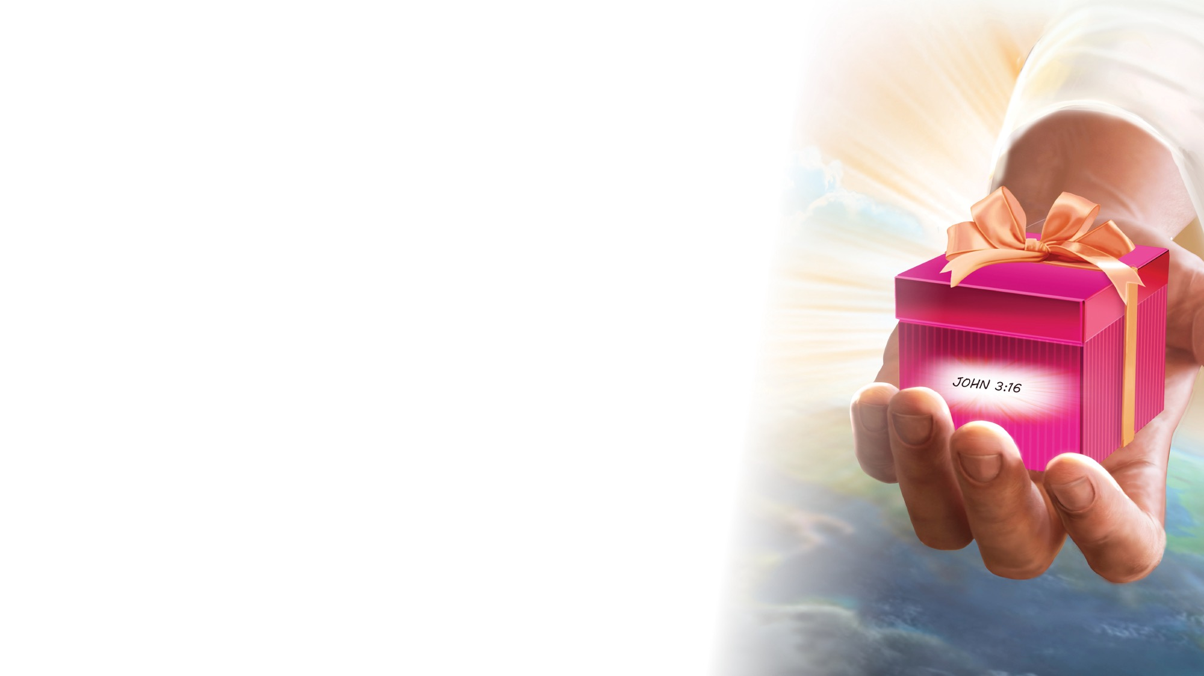
OFFERING

Slide 14

Thank You, Jesus
OPENING ACTIVITIES
Thank you, Jesus
For providing all my needs.
I want to give a little back
Of what you’ve given me.
Please bless our
Sabbath School offering.
May it bring You glory
And help others in need.
(Repeat above)
May it bring You glory
And help others in need.
"Thank You, Jesus" by Rosie Smith, copyright © 2024 General Conference Corporation® of Seventh-day Adventists.

Slide 15
MISSION
FAST FACT &
OFFERING
CHART

Slide 16
Visitor Song
OPENING ACTIVITIES
We have a new friend
With us today.
We have a new friend.
Let’s smile and wave.
We welcome you to Sabbath School.
We’re glad you came.
We welcome you,
And hope to see you again. (x2)
“Visitor Song” by Rosie Smith. Copyright © 2025 General Conference Corporation® of Seventh-day Adventists.

Slide 17
Happy Birthday
OPENING ACTIVITIES
Happy birthday, happy birthday,
Happy birthday to you.
Jesus loves you dear ___________.
Happy birthday to you.
(Repeat above)
“Happy Birthday” by Janet Sage, copyright © 2001 North American Division Corporation of Seventh-day Adventists. From Little Voices Praise Him, #39. Used by permission.

Slide 18

FOCUS
ACTIVITIES

Slide 19
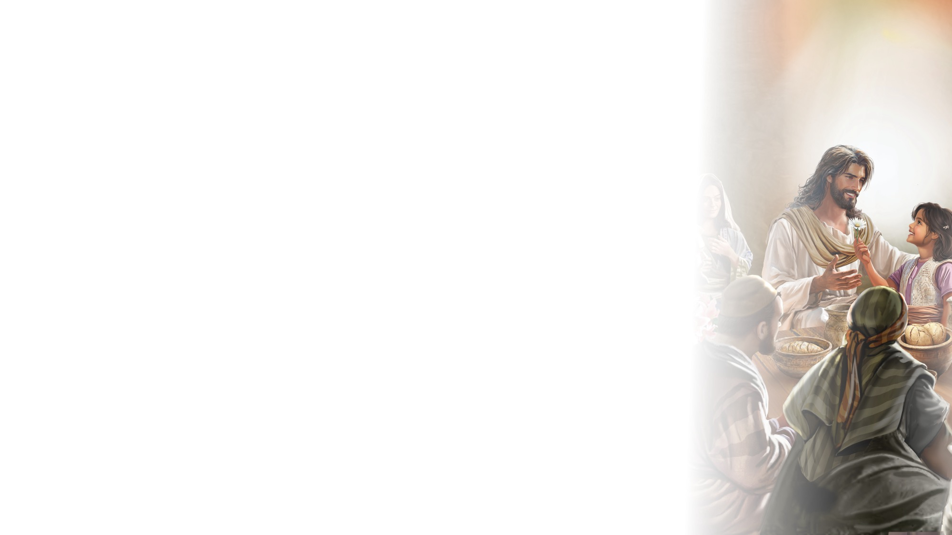
BIG IDEA
Jesus teaches me and nurtures my faith so that I can grow as His disciple.

Slide 20
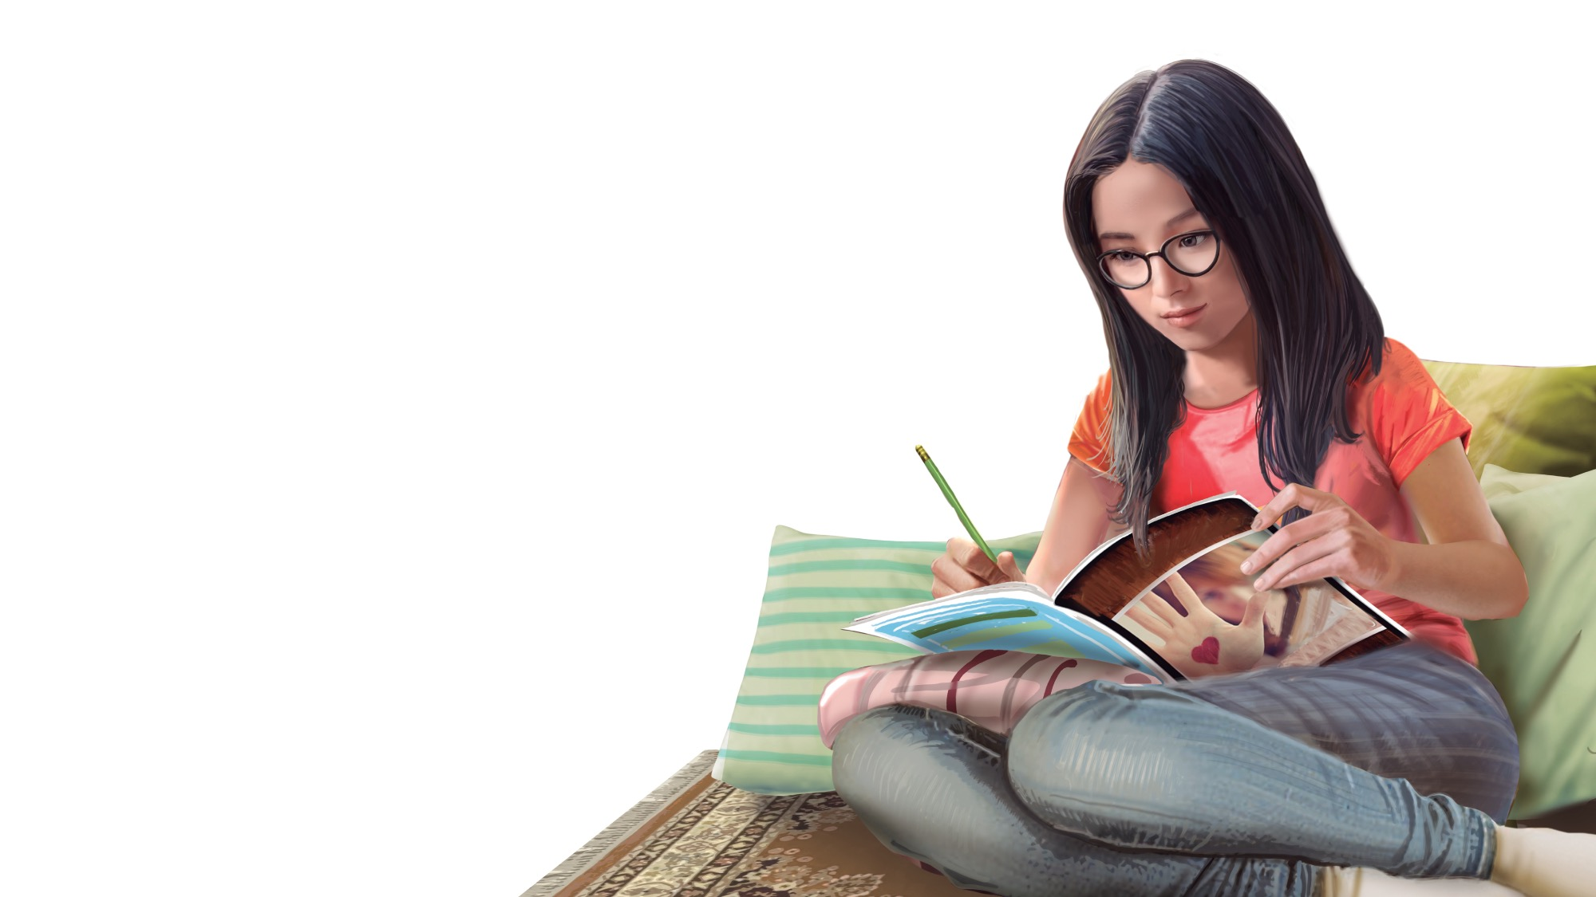
BIBLE
STORY

Slide 21
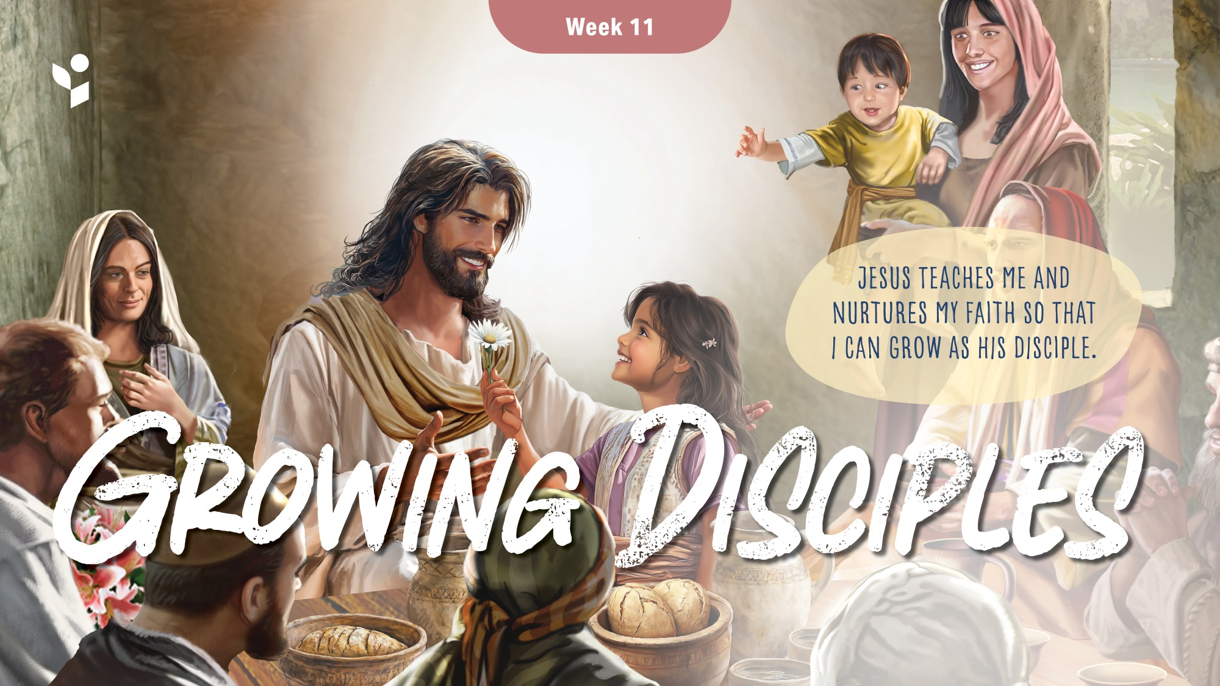

Slide 22
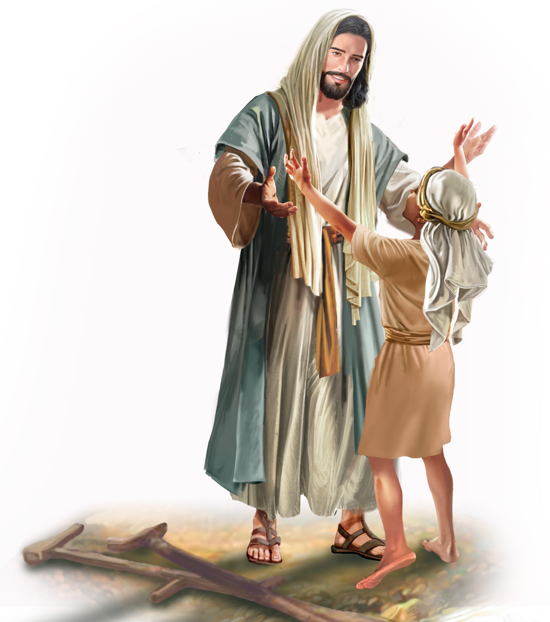
Illustration by Jo Card. Copyright © 2024 General Conference Corporation® of Seventh-day Adventists.

Slide 23
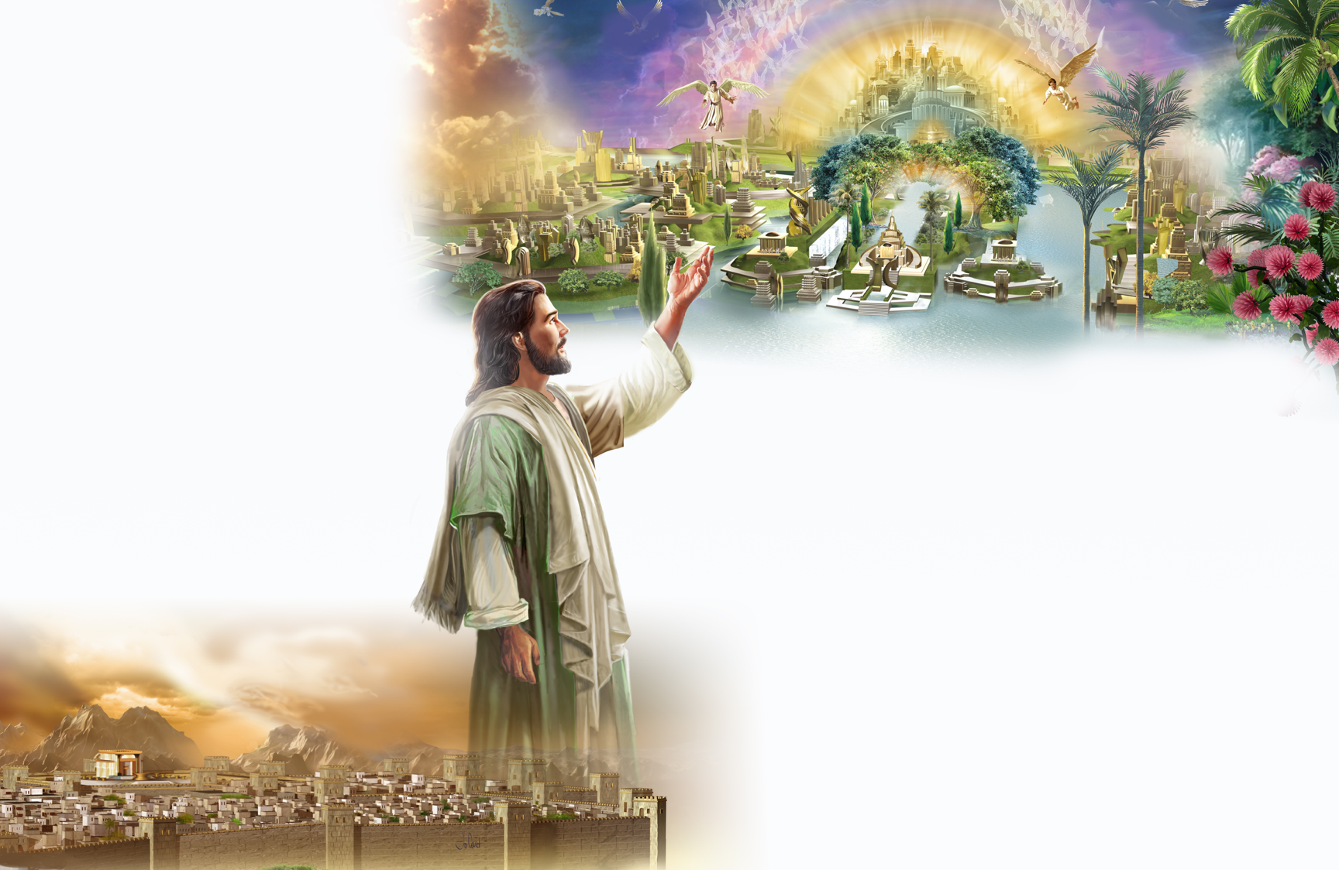
Illustration by Jo Card. Copyright © 2024 General Conference Corporation® of Seventh-day Adventists.

Slide 24
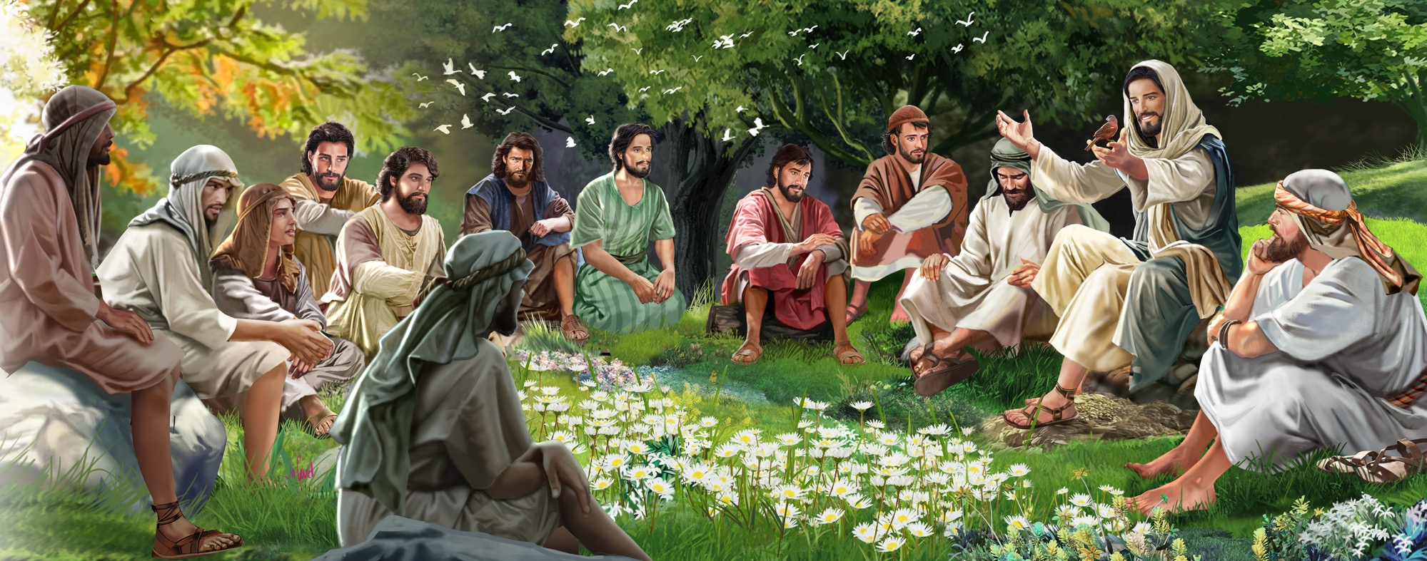
Illustration by Jo Card. Copyright © 2024 General Conference Corporation® of Seventh-day Adventists.

Slide 25
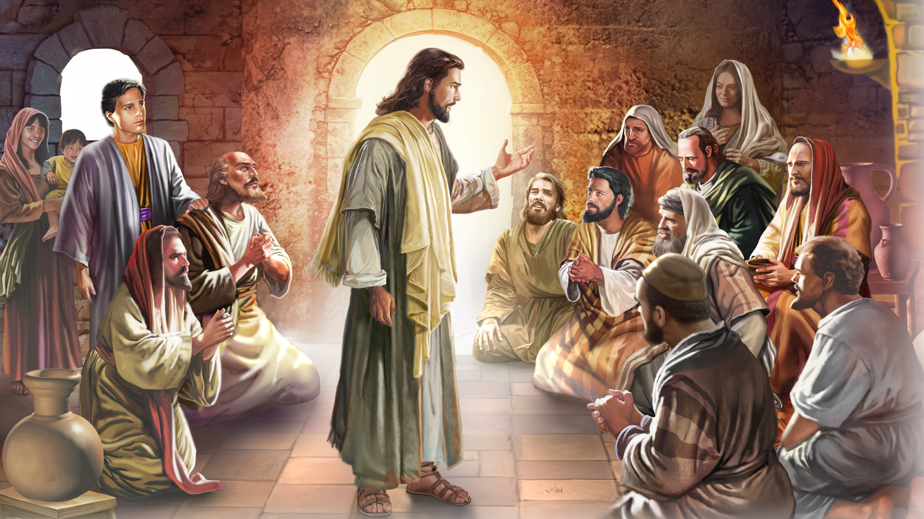
Illustration by Jo Card. Copyright © 2024 General Conference Corporation® of Seventh-day Adventists.

Slide 26
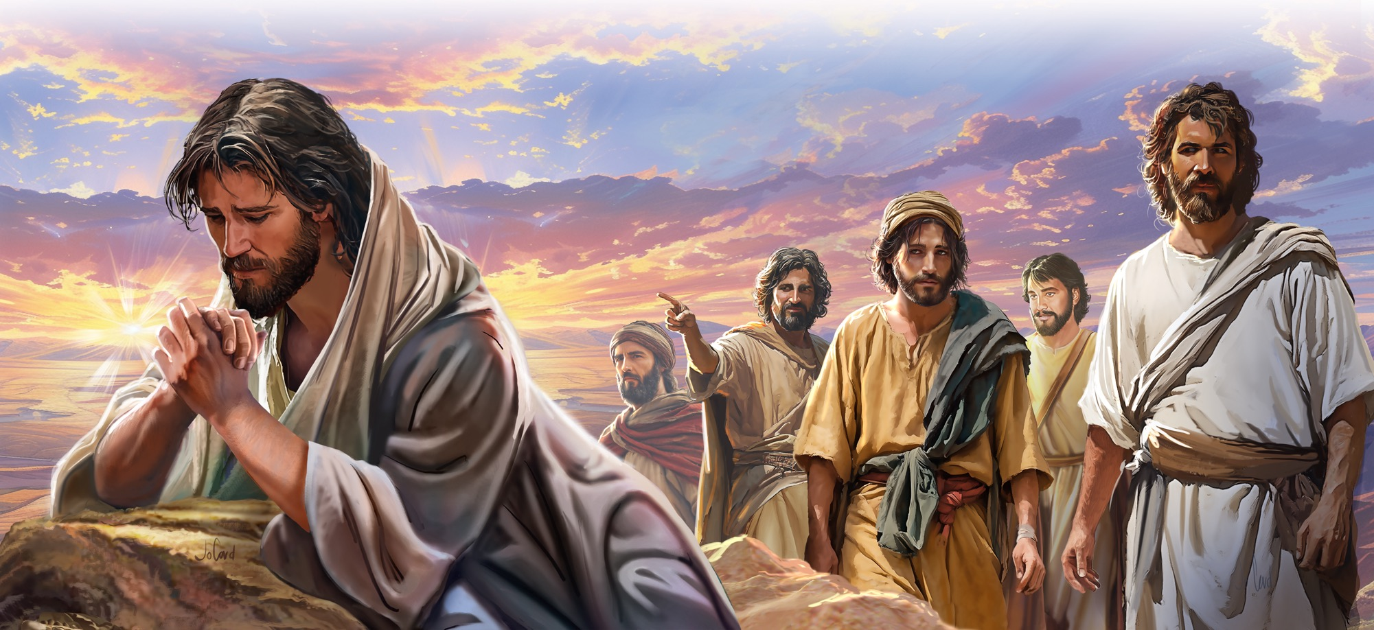
Illustration by Jo Card. Copyright © 2024 General Conference Corporation® of Seventh-day Adventists.

Slide 27
UNPACK
THE STORY

Slide 28

CHARACTER CARDS

Slide 29
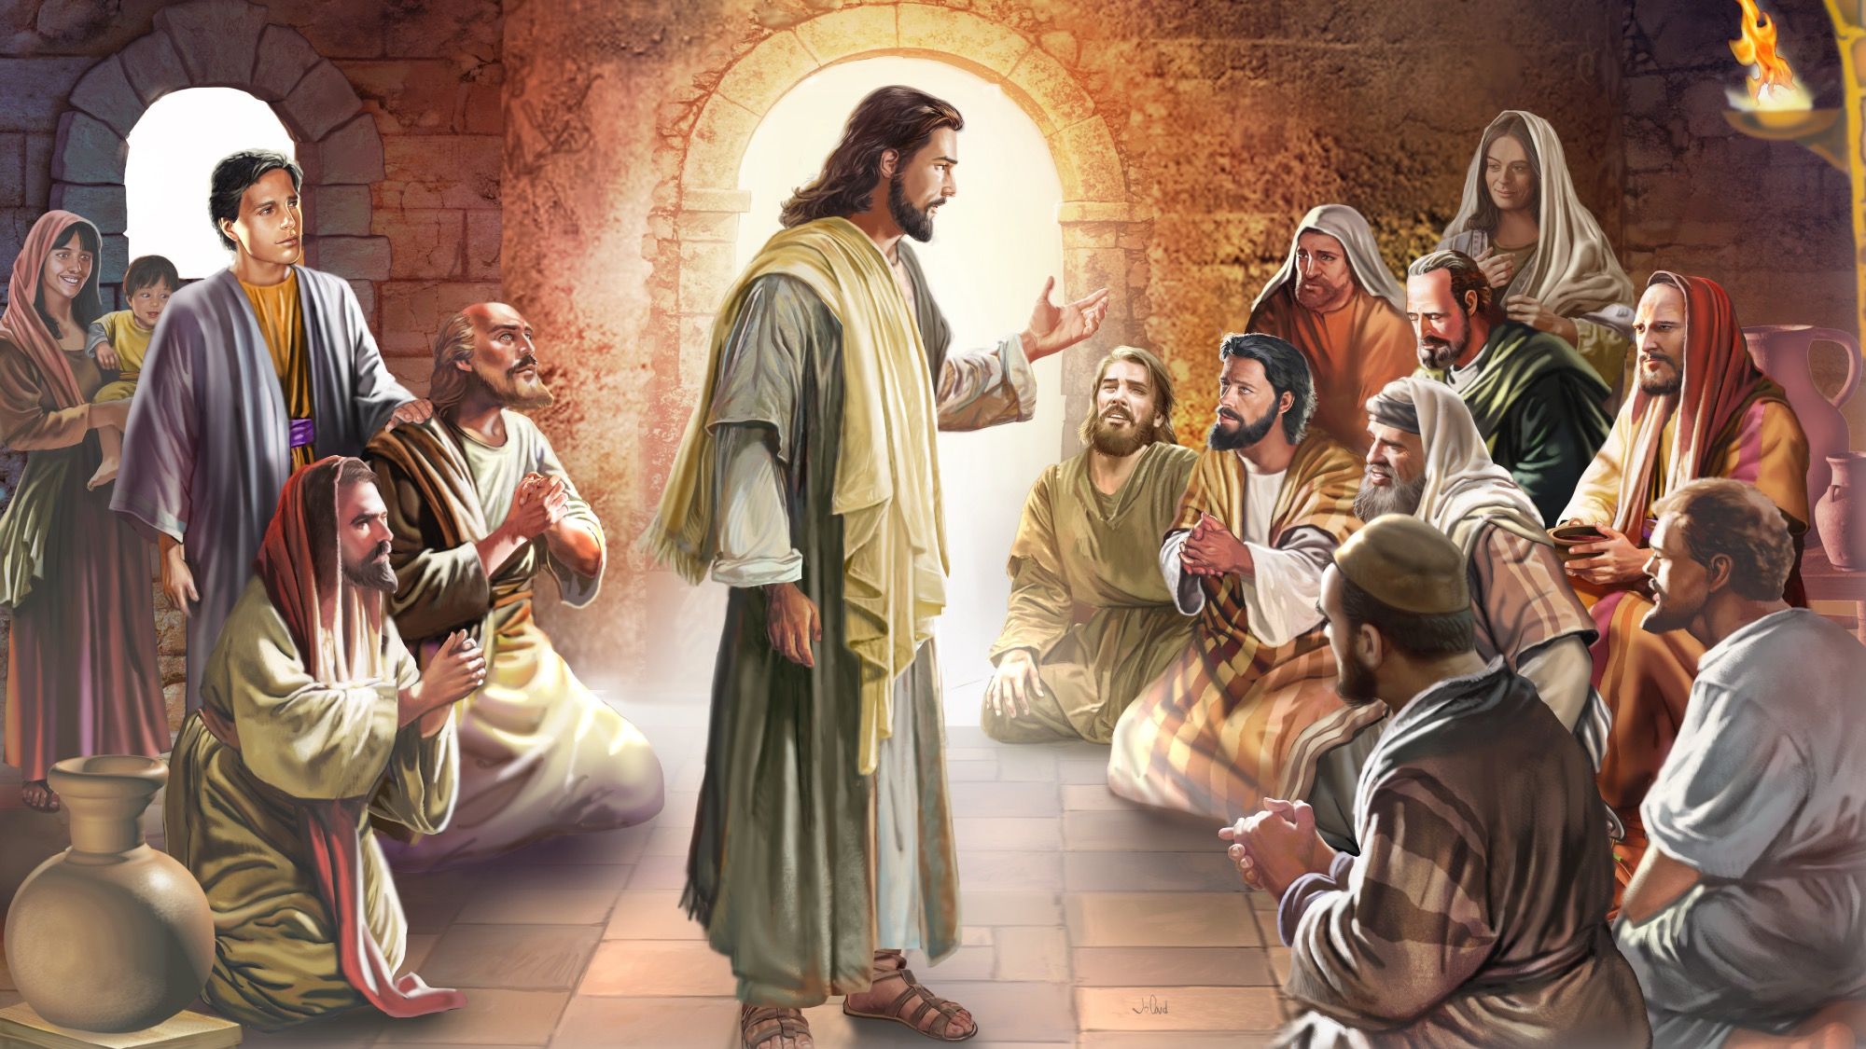
MEMORY VERSE
“By this all will know that you are My disciples, if you have
love for one another.”
John 13:35

Slide 30
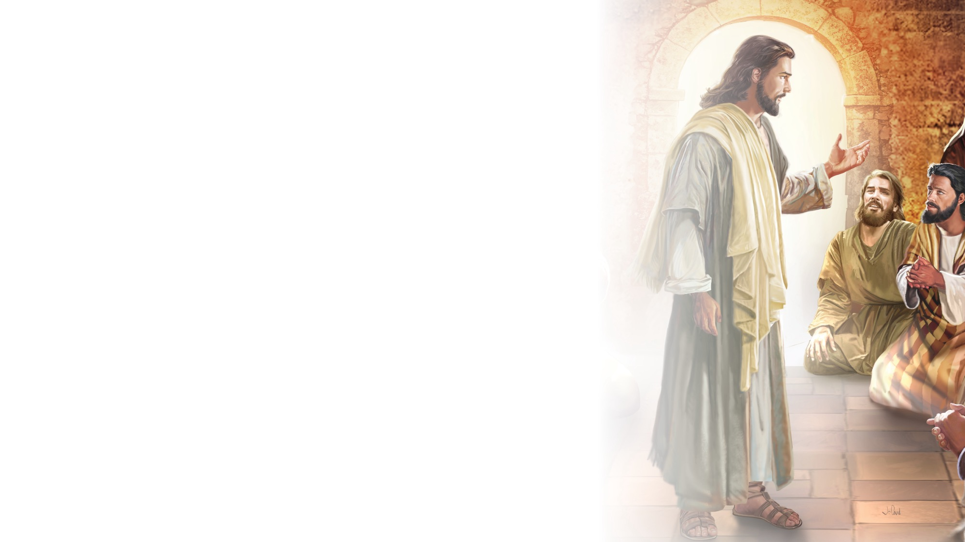
John 13:35
SCRIPTURE SONG
By this all will know
That you are My disciples,
If you have love
For one another.
John 13 verse 35.
(Repeat above)
"John 13:35" music by Rosie Smith, copyright © 2026 General Conference Corporation® of Seventh-day Adventists.

Slide 31

MISSION
STORY

Slide 32

CRAFT

Slide 33
The Lord’s Prayer
CRAFT
"The Lord's Prayer" by Leanne Erickson, copyright © 2018 Leeann Erickson. Used by permission.

Slide 34
MISSION
CHALLENGE

Slide 35
BIG IDEA
Jesus teaches me and nurtures my faith so that I can grow as His disciple.

Slide 36

PRAYER
PRAYER

